Slide 1
Improving Aerial Object Detection: Deep Learning Insights from RarePlanes Satellite Dataset
Group 12:
Abdelrahman Rateb (87521)
Aljawharah Alanazi (91308)
Lamis Elsayed (87174)
Johnny Kortbawi (88581)

Slide 2
Introduction
As satellite technology and advancements in computer vision and deep learning continue to evolve, the problem of aircraft detection becomes more vital.
Airplanes serve as means of exchange and communication, are crucial in maintaining national security, and can be used for national aid efforts
Challenges faced by researchers in aircraft detection include
Variations in the aircraft’s:
Orientation
Size
Shape
Complexity of the sky’s background
Potential occlusion by other objects like clouds

Slide 3
Problem Statement
Problem Statement: This project addresses the challenge of accurately detecting aircraft in satellite imagery, hindered by variations in aircraft orientation, size, and complex backgrounds.
To address these challenges with the use of the Rareplanes dataset, we aim to investigate and refine deep learning models to reliably differentiate aircraft from other elements under real conditions, enhancing detection capabilities for improved global security and emergency response applications in realistic environments.

Slide 4
Literature Review
Initially, works using the same dataset in addition to works using similar datasets were explored. Below are our three top papers:
J. Shermeyer, T. Hossler, A. Van Etten, D. Hogan, R. Lewis, and D. Kim, “RarePlanes: Synthetic data takes flight,” in 2021 IEEE Winter Conference on Applications of Computer Vision (WACV 2021), 2021, IEEE. doi: 10.1109/WACV48630.2021.00025
S. Hussaini, J. James, and J. J. Ford, “Vision-based aircraft detection using deep learning with synthetic data,” in Australian Conference on Robotics and Automation (ACRA 2020), 2020, Australian Robotics and Automation Association (ARAA).
A. Van Etten, “Satellite imagery multiscale rapid detection with windowed networks,” in 2019 IEEE Winter Conference on Applications of Computer Vision (WACV 2019), 2019, IEEE. doi: 10.1109/WACV.2019.00083

Slide 5
Literature Review
RarePlanes: Synthetic Data Takes Flight [1]
Dataset: RarePlanes
Real Data
Synthetic Data
Models: Faster R-CNN , Mask R-CNN
Results:
Vision-based Aircraft Detection Using Deep Learning with Synthetic Data [2]
Dataset: Synthetic dataset of videos of different aircraft trajectories captured under different weather conditions
Model ⇒ 4 stacks of a Convolutional LSTM Layer + Batch Normalization Layer + Convolutional 3D Layer
Results:
Satellite Imagery Multiscale Rapid Detection with Widowed Networks [3]
Dataset: Satellite images of cars, boats, airplanes, and airports
Models: YOLT, SSD, Faster R-CNN, R-FCN
Results:
You-Only-Look-Twice (YOLT) architecture achieved the highest mAP value of 0.68
Metric | Real Data | Synthetic Data
mAP | 73.32 | 54.86
mAP50 | 96.80 | 87.03
AR | 77.16 | 60.67
Metric | Clear Conditions |  | Cloudy Conditions
 | Case 1 | Case 2 | Case 1 | Case 2
TPR | 69.37% | 78.30% | 42.30% | 61.33%

Slide 6
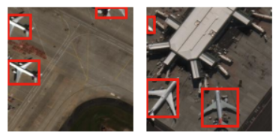
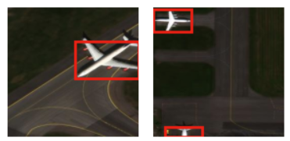
Methodology
Dataset ⇒ RarePlanes Dataset
Comprises real and synthetic images of the overhead view of aircrafts from a satellite
Utilizing only the real images for the scope of this project
8525 Total Real Images
Images come with annotations files (json files)
Uploaded to Roboflow
Data Preprocessing ⇒ Images were resized to 256 x 256
Train-Validate-Test Split ⇒ 60-20-20
5115 training images
1705 validation images
1705 testing images
Models Run ⇒ YOLOv8 , YOLOv9 , DETR , RetinaNet
Sample Dataset Records

Slide 7
Implementation
Model I: YOLOv8
Architecture:
53 convolutional layers
CSPNet backbone
Integrates self-attention mechanism and feature pyramid network
Images were processed in batches of 16
Training the Model:
Number of Epochs = 20

Slide 8
Implementation
Model II: YOLOv9
General Information:
Latest version of YOLO
Programmable Gradient Information (PGI) and the Generalized Efficient Layer Aggregation Network (GELAN) are introduced in its architecture
PGI helps overcome the information bottleneck problem in deep learning
“The design of GELAN allows for flexible integration of various computational blocks, making YOLOv9 adaptable to a wide range of applications without sacrificing speed or accuracy.” (Ultralytics Documentation)
Images were processed in batches of 16
Training the Model:
Number of Epochs = 20
Learning Rate = 0.01
Momentum = 0.937

Slide 9
Implementation
Model III: DETR
Architecture:
Backbone: Convolutional Blocks (Feature Extraction)
Positional Embedding: DetrSinePositionEmbedding (Adds information about feature location)
Transformer Encoder: Self-Attention, Layer Normalization (Enhances Extracted Features)
Transformer Decoder: Object Queries, Cross-Attention ( Decodes the Encoded Features to Help Prediction)
Prediction Heads: Class Labels Classifier, Bounding Box Predictor (Predict Class and Bounding Box)
Images were processed in batches of 16
Training the Model:
Number of Epochs = 5
Learning Rate = 0.0001
Weight Decay = 0.0001

Slide 10
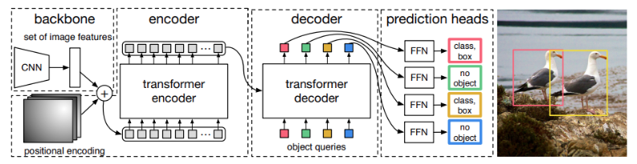
Implementation
Model III: DETR

Slide 11
Implementation
Model IV: RetinaNet
Architecture:
RetinaNet is built on the Feature Pyramid Network (FPN), allowing efficient detection of objects of different sizes.
FPN generates a multi-scale feature pyramid using feature maps, enabling detection across various scales, improving handling of small and large objects simultaneously.
Images were processed in batches of 16
Training the Model:
Number of Epochs = 10
Learning Rate = 0.001
Optimizer = Adam

Slide 12
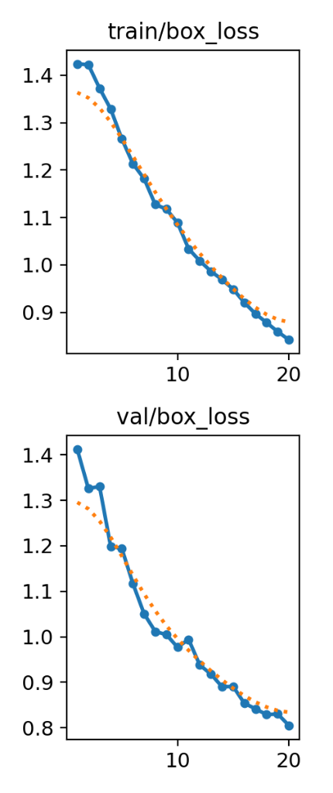
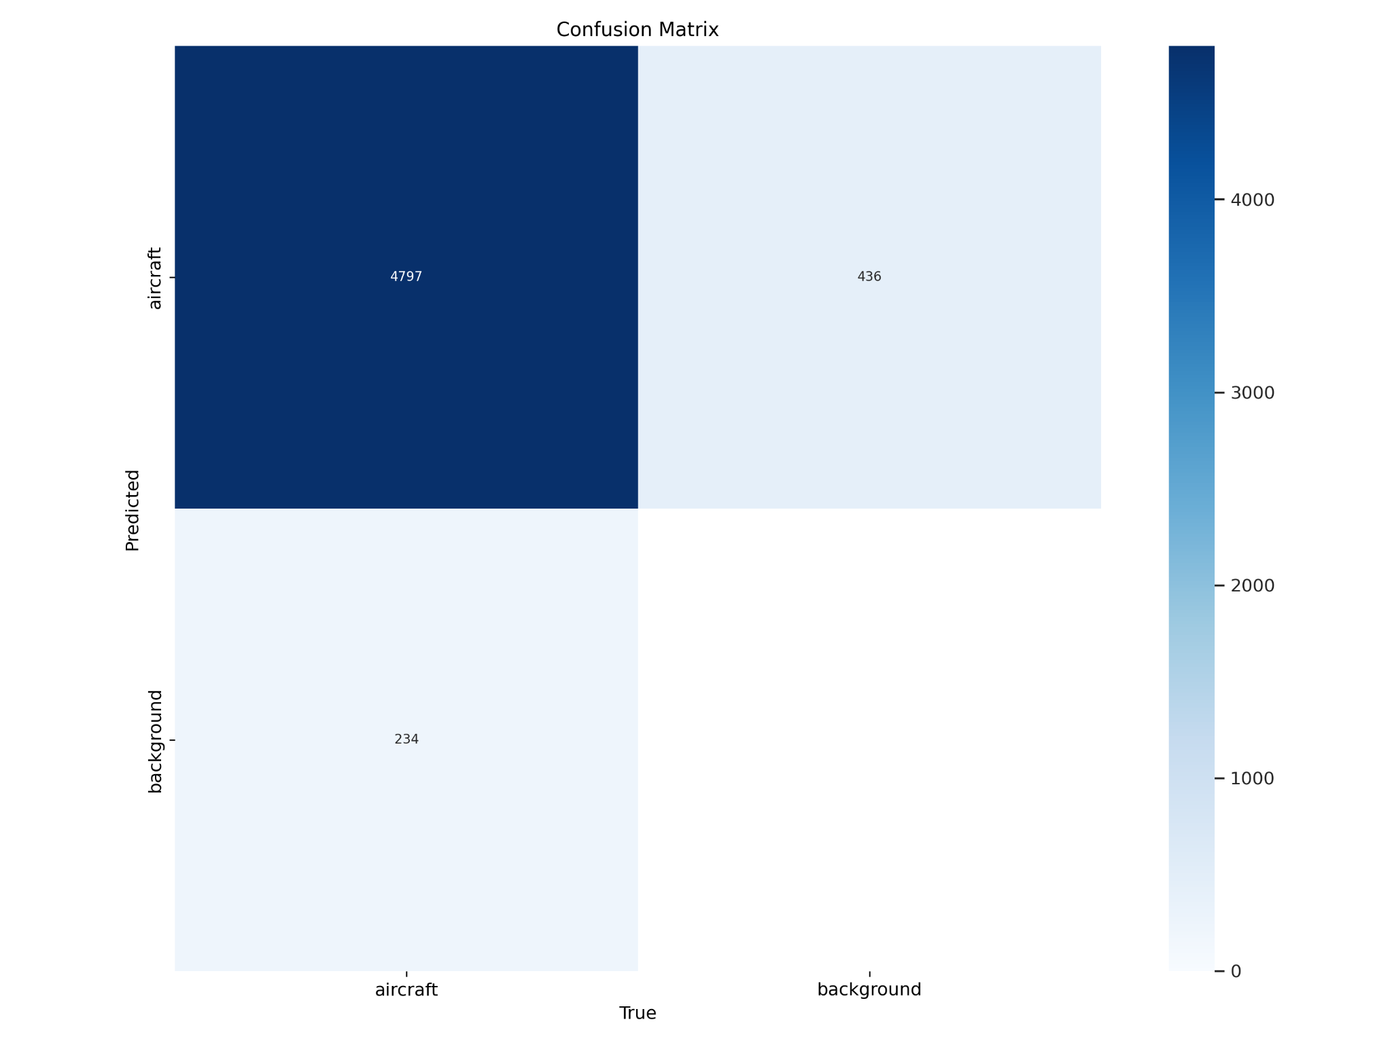
Results
YOLOv8

Slide 13
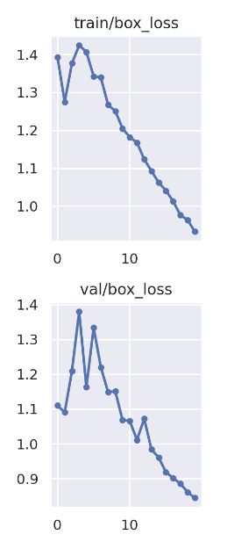
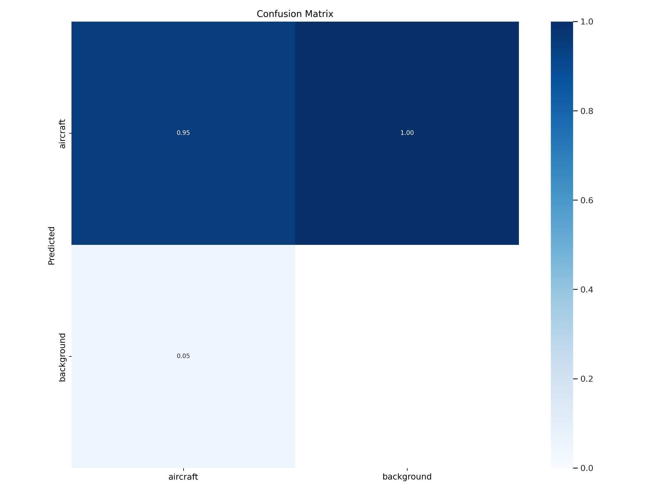
Results
YOLOv9

Slide 14
Results
DETR

Slide 15
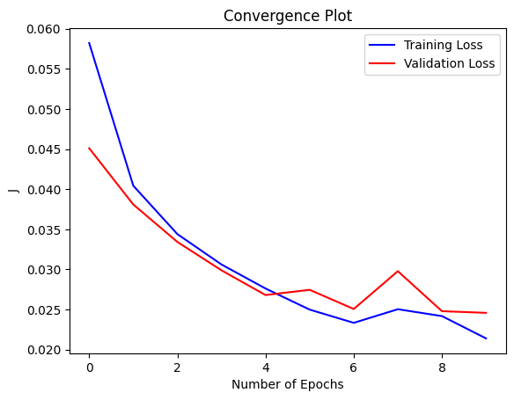
Results
RetinaNet

Slide 16
Performance Evaluation
The following metrics were used to evaluate the performance of our models:
Model | Metric
 | Precision | Recall | Mean Average Precision (mAP)
YOLOv8 | 96.6% | 92.4% | mAP50 = 97.6% mAP50-95 = 75.1%
YOLOv9 | 96.5% | 92.1% | mAP50 = 97.5% mAP50-95 = 74.2%
DETR | 86.6% | 58.6% | mAP50 = 86.6% mAP50-95 = 50.4%
RetinaNet | 99.9% | 35.6% | 35.6%

Slide 17
Discussion
Our dataset achieved the highest performance when run on the two YOLO models, YOLOv8 and YOLOv9, achieving a good balance between precision and recall
Yielded similar recall scores of 92.4% and 92.1%, respectively
Models are able to identify most instances of the positive class correctly
Achieved similar precision scores of 96.6% and 96.5% scores respectively, indicating that a high proportion of the predictions made by the models are correct.
DETR achieves a relatively lower recall value of 58.6% and precision value of 86.6%.
Interestingly, RetinaNet achieves the highest precision value of 99.9, but with an extremely low recall and mAP values of 35.6%.
This means that RetinaNet is only detecting a small number of objects, but most of those detections are correct
Metric | YOLOv8 | Faster R-CNN from Reviewed Work [1]
mAP-50-95 | 75.1 | 73.32
mAP-50 | 97.6 | 96.80
Overall, when examining the mAP metrics, as displayed in the table, our YOLOv8 outperformed the Faster R-CNN model used by the authors of [1]

Slide 18
Work Division
Task | Responsible Team Member
Research & Documentation
Preliminary Research & Selecting Dataset | All Team Members
Literature Review | All Team Members
Presentation | All Team Members
Implementation
Model I: YOLOv8 | Abdelrahman & Johnny
Model II: YOLOv9 | Aljawharah & Lamis
Model III: Detection Transformer (DETR) | Abdelrahman & Johnny
Model IV: RetinaNet | Aljawharah & Lamis

Slide 19
Demonstration

